Slide 1
Sparse Matrix
A matrix is a two-dimensional data object made of m rows and n columns, therefore having total m x n values. If most of the elements of the matrix have 0 value, then it is called a sparse matrix.
Example:
0 0 3 0 4
0 0 5 7 0
0 0 0 0 0
0 2 6 0 0

Slide 2
Why to use Sparse Matrix instead of simple matrix ?
Storage: There are lesser non-zero elements than zeros and thus lesser memory can be used to store only those elements.
Computing time: Computing time can be saved by logically designing a data structure traversing only non-zero elements..

Slide 3
Sparse Matrix Representations
Sparse Matrix Representations can be done in many ways following are two common representations:
Array representation
Linked list representation

Slide 4
Using Arrays
2D array is used to represent a sparse matrix in which there are three rows named as
Row: Index of row, where non-zero element is located
Column: Index of column, where non-zero element is located
Value: Value of the non zero element located at index – (row,column)

Slide 5
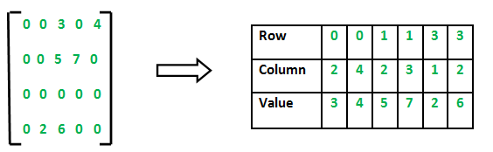
Using Arrays

Slide 6
Code
// Making of new matrix
int k = 0;
for (i = 0; i < 4; i++) {
for (j = 0; j < 5; j++) {
if (sparseMatrix[i][j] != 0)
{
compactMatrix[0][k] = i;
compactMatrix[1][k] = j;
compactMatrix[2][k] = sparseMatrix[i][j];
k++;
}
}
}

Slide 7
Using Linked Lists
In linked list, each node has four fields. These four fields are defined as:
Row: Index of row, where non-zero element is located
Column: Index of column, where non-zero element is located
Value: Value of the non zero element located at index – (row,column)
Next node: Address of the next node

Slide 8
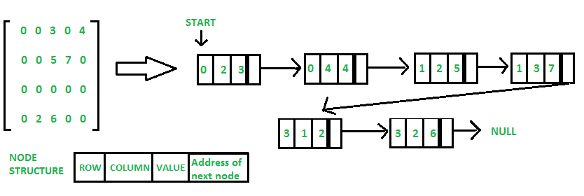
Using Linked Lists

Slide 9
void create_new_node(struct Node** start, int non_zero_element, int row_index, int column_index ) {
struct Node *temp, *r; temp = *start;
if (temp == NULL) {
// Create new node dynamically
temp = (struct Node *) malloc (sizeof(struct Node));
temp->value = non_zero_element;
temp->row_position = row_index;
temp->column_postion = column_index;
temp->next = NULL;
*start = temp; }
else {
while (temp->next != NULL) temp = temp->next;
// Create new node dynamically
r = (struct Node *) malloc (sizeof(struct Node));
r->value = non_zero_element;
r->row_position = row_index;
r->column_postion = column_index;
r->next = NULL;
temp->next = r; } }

Slide 10
for (int i = 0; i < 4; i++) {
for (int j = 0; j < 5; j++) {
if (sparseMatric[i][j] != 0)
create_new_node(&start, sparseMatric[i][j], i, j);
}
}

